Slide 1

KCEditor on Web
KC Team
9/3/2015
Notes:
Course Review Committee:
Review Date:

Slide 2
Outline
KCEditor on Web
Current KCEditor’s Limitation
KCEditor on Web
Technical Approach
Implemented features
Demonstration

Slide 3
Current KCEditor’s Limitation
KCEditor on Web
Only run offline on Windows
User has to install, (upgrade when have new version) KCE
Require permissions on user’s machine
Expose open source usage

Slide 4
KCEditor on Web
KCEditor on Web
Advantages
Online solution
Modern Responsive UI, conform with new SA UI
Easy to maintain and upgrade
Apply modern technologies
Limitation
Upload package to server before composing(same as Publisher mechanism)
Specific features designed for Desktop Application are not suitable for Web Application and could be eliminated or redesigned: Undo/Redo, Apply Global Changes,...

Slide 5
Technical Approach
KCEditor on Web
Use current KCEditor Core and transform it to Web Service using Spring MVC
Build UI front-end using HTML5, AngularJS and Bootstrap
Build interaction between front-end and back-end through Spring Web API

Slide 6
KCEditor on Web
DB
(User, packages information)
User
Tomcat Server
(KCE core, Spring MVC API)
Web UI
(HTML5, AngularJS, Bootstrap)
Publisher API
Content Server

Slide 7
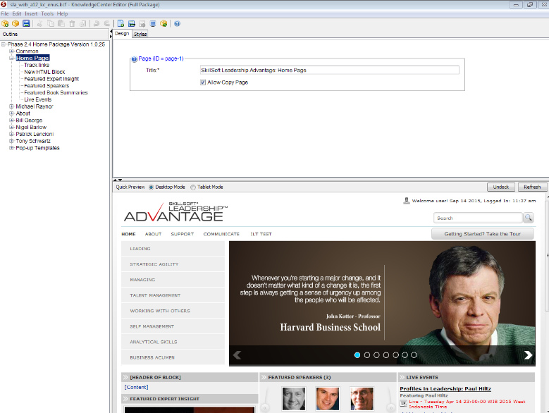
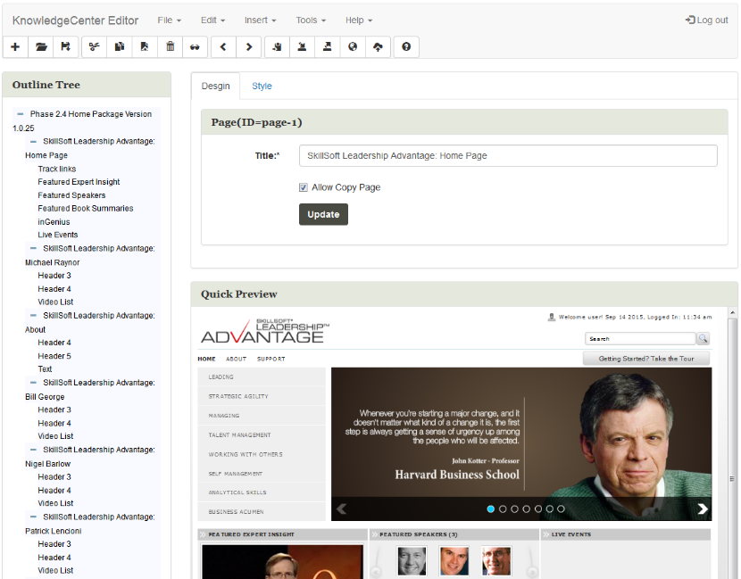
Implemented features
KCEditor on Web
Upload/Open package
Modify package title
Delete a block in page
Save package
Publish package to server

Slide 8
Thank You.
Notes:
Course Review Committee:
Review Date:

Slide 9
Revision History
KCEditor on Web
Date | Version | Description | Updated by | Reviewed and Approved By
9/3/2015 | 0.1 | Initial Draft | Quy Nguyen

